Slide 1
www.MINEPORTAL.in
ONLINE TEST SERIES FOR
DGMS COAL/METAL FIRST/SECOND CLASS EXAM
GATE MINING EXAM
OVERMAN EXAM TEST
MINING INSPECTOR EXAMS
COAL INDIA MTs & OTHER PSUs EXAMS
FREE STUDY MATERIAL & VIDEO LECTURES
MINING JOBS NOTIFICATIONS
www.mineportal.in Call/Whatsapp-8804777500 www.fb.com/mineportal.in

Slide 2
SOLUTION OF A SIMPLEX PROBLEM USING EXCEL

Slide 3
Excel’s Solver Add-In
The worksheet utilizes Excel’s Solver Add-In to find the solution to the linear programming problem. Before we can create this worksheet, the Solver Add-In must be installed within Excel.
Steps to be followed for loading the Solver Add-In:
Select the Add-Ins icon on the top of the sheet.
To add the Solver Add-In, click in the Manage area and select Excel Add-ins Press Go.
In the Add-Ins box that appears, click in the box next to Solver Add-in to put a check in the box. Click OK. The Solver Add In is now ready to use

Slide 4
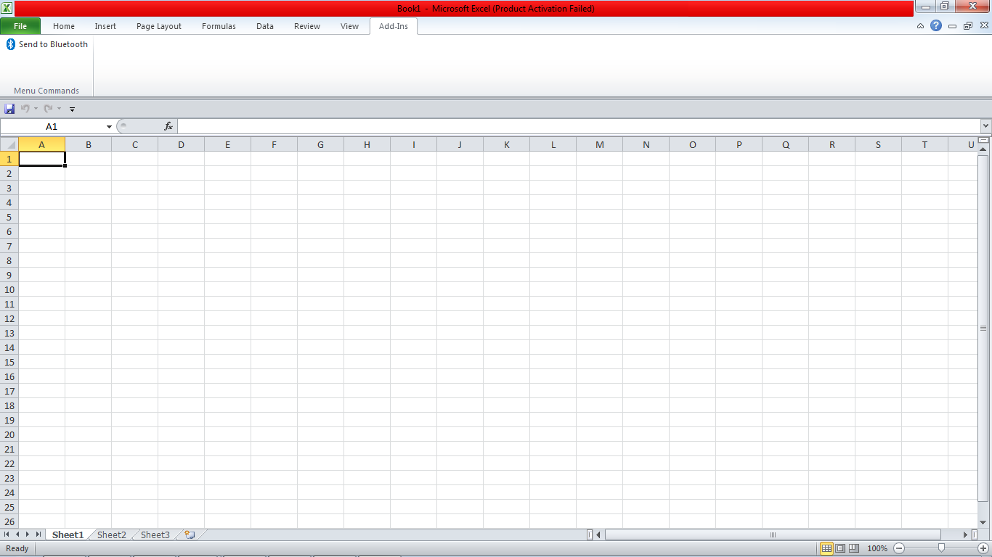

Slide 5
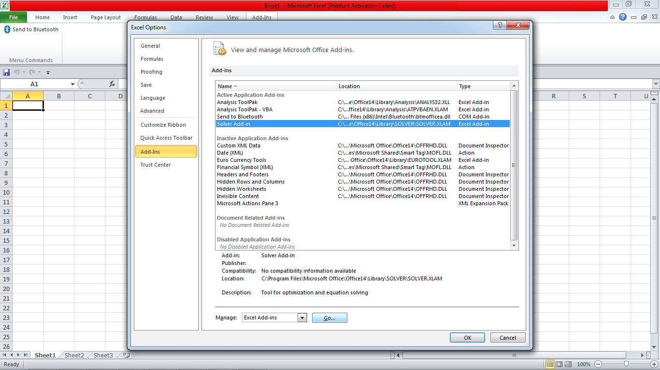

Slide 6
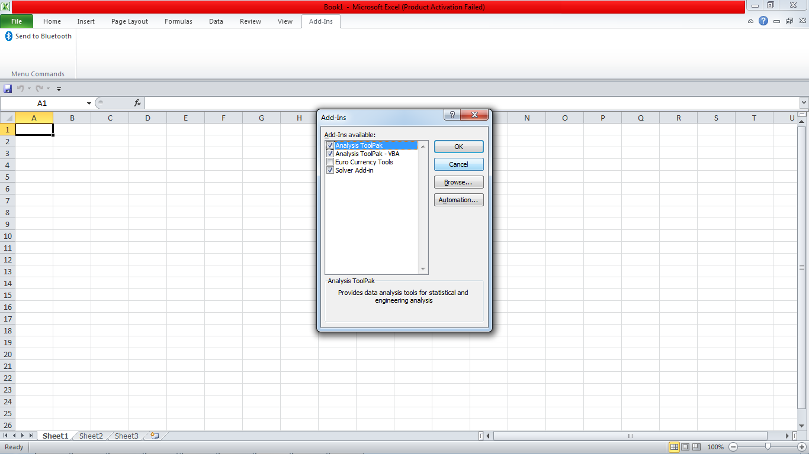

Slide 7
The linear programming problem is as follows :
Maximize Z= 6x+5y
Subject to the constraints x+y<=5
3x+2y <=12
x,y >=0

Slide 8
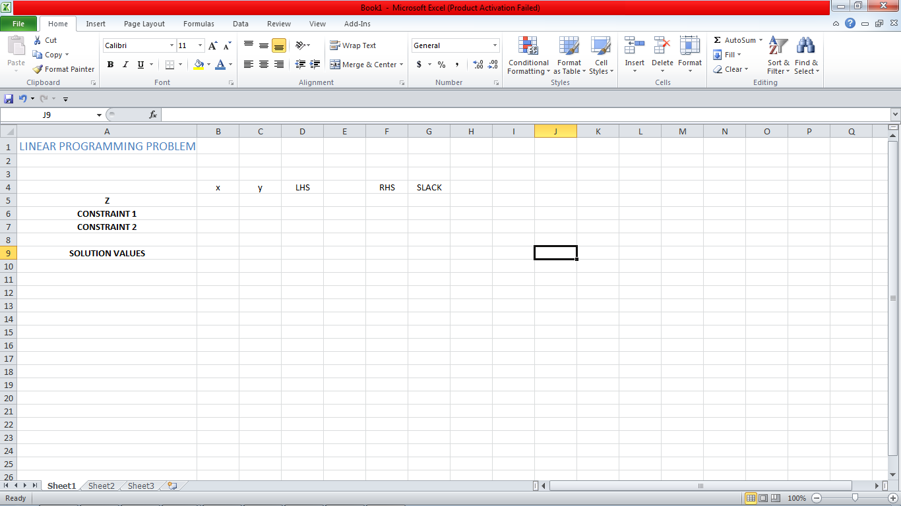
Now we can begin to make the worksheet that we’ll use to solve the linear programming problem. Enter the text show below in the individual cells.

Slide 9
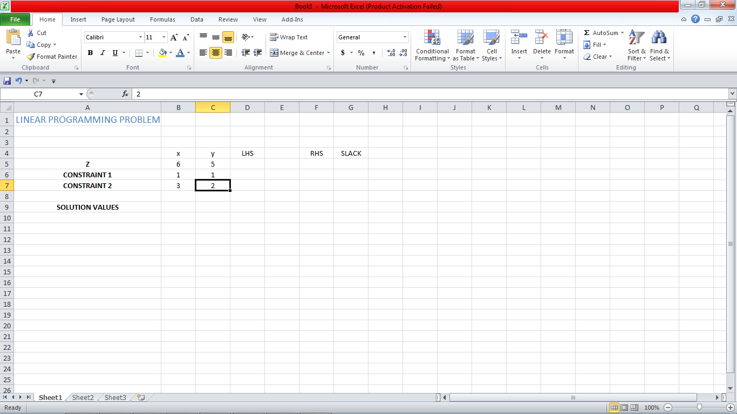
Enter the coefficients of the objective function on the line labeled “Z” and Enter the coefficients of the constraints in the lines labeled “Constraint1” and “Constraint 2”.

Slide 10
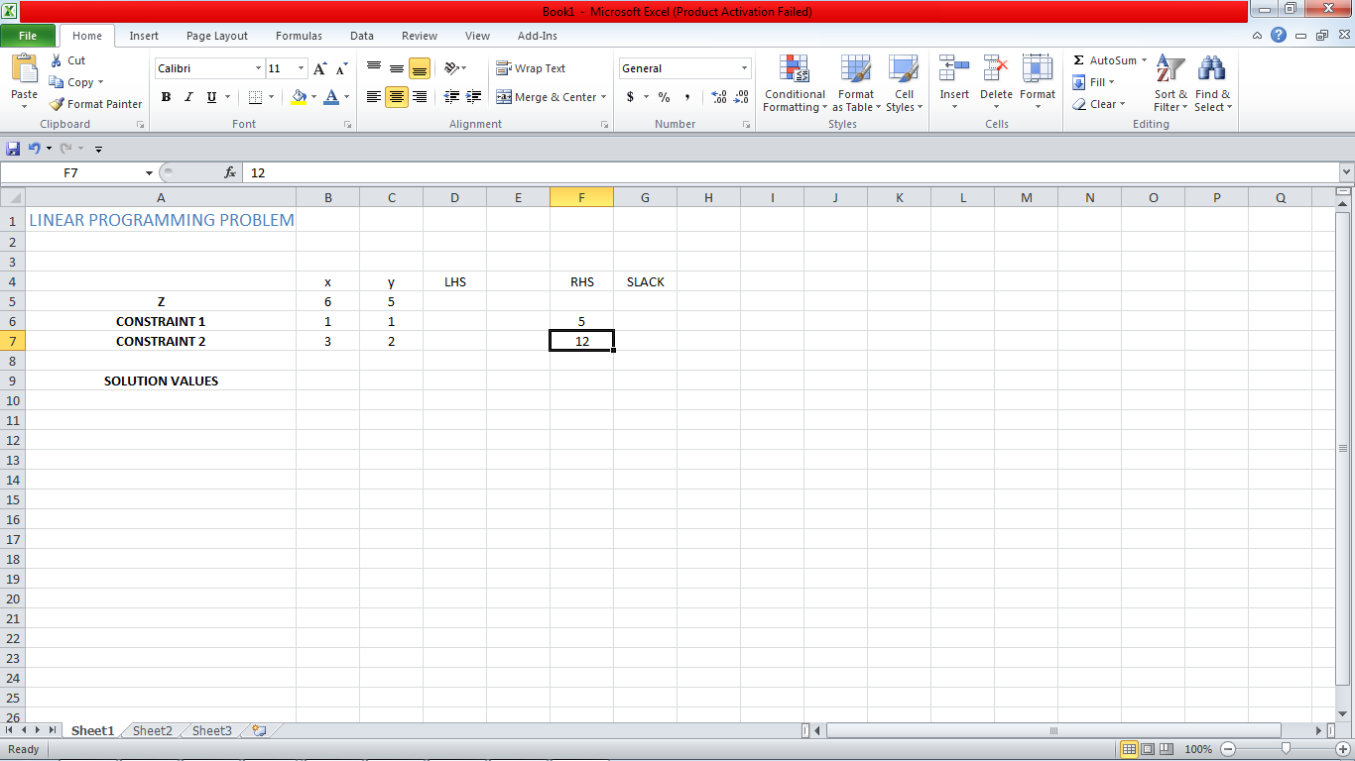
Enter the right hand sides for each constraint in the appropriate row in the column labeled “RHS”.

Slide 11
In the row labeled “Solution Values”, enter an initial guess for the solution . These values can be just about any non-negative number. In this worksheet we use the values (x, y) = (0,0) for simplicity. The cells you place the guesses in,B9 and C9, are called the changing cells. These values are used to evaluate the objective function and left hand side of the constraints. Place the appropriate inequalities in each constraint’s row.

Slide 12
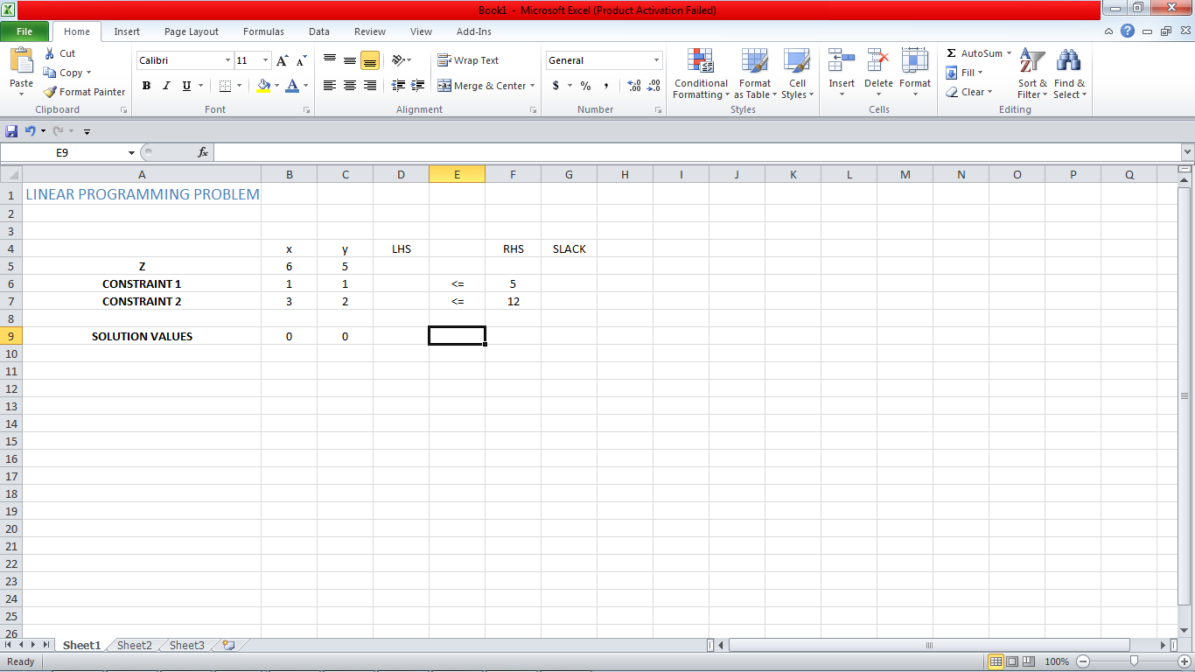

Slide 13
In cell D5 we want to calculate the value of the objective at the solution values in cells B9 and C9. This cell is called the target cell. Click your mouse in the target cell.
In the formula area, type =SUMPRODUCT($B$9:$C$9,B5:C5). Press Enter on the keyboard. The SUMPRODUCT function multiplies corresponding cells and adds the results. In this case, the solution values in B9 and C9 are multiplied times the objective function coefficients in B5 and C5. The sum of these products is placed in the target cell

Slide 14
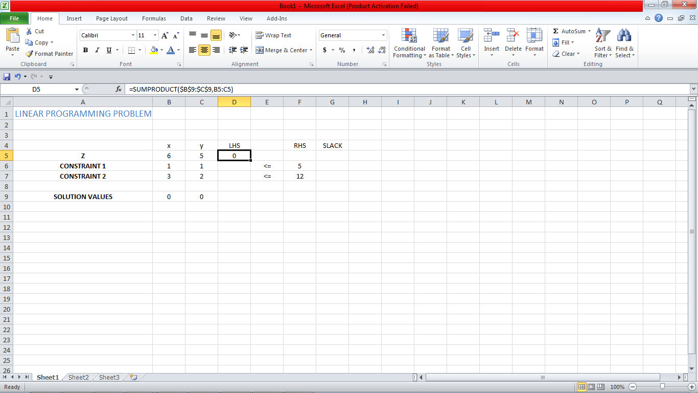

Slide 15
The dollars signs used in above step are called absolute references. Absolute references are useful when fills are used to create entries in cells. Click on cell D5 again. Notice the darker box in the lower right hand corner of the cell. This box is called the fill handle. Move your cursor over this box and you’ll see that it changes to a black cross . Left mouse click and hold the mouse button down while dragging the cursor to cell D7 . Release the mouse button.

Slide 16
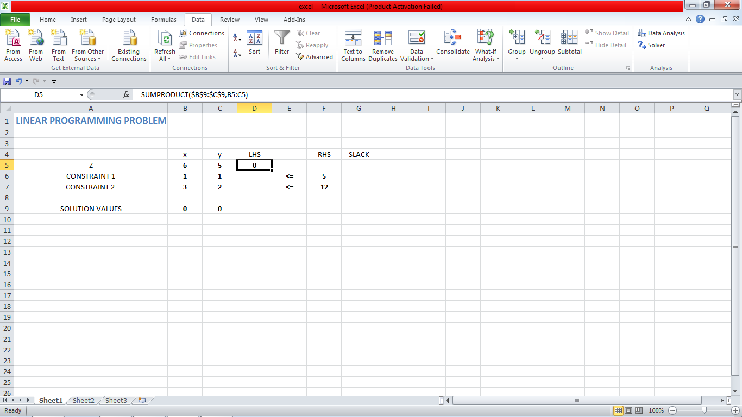
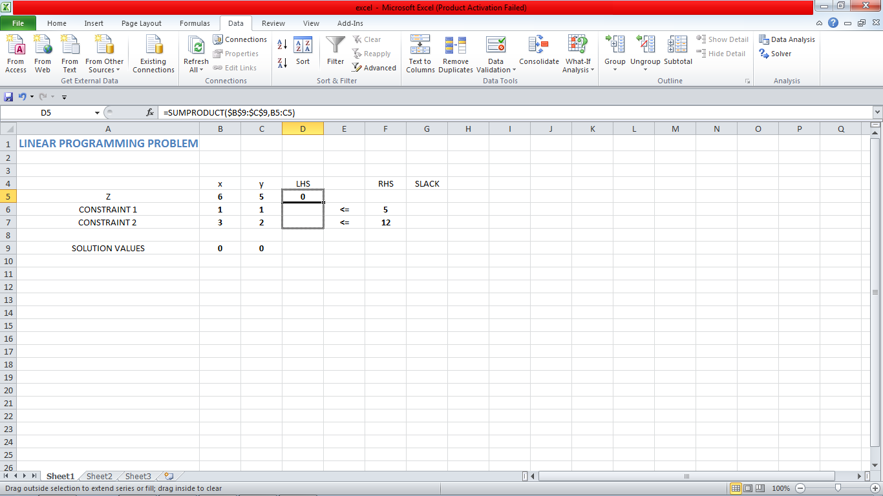
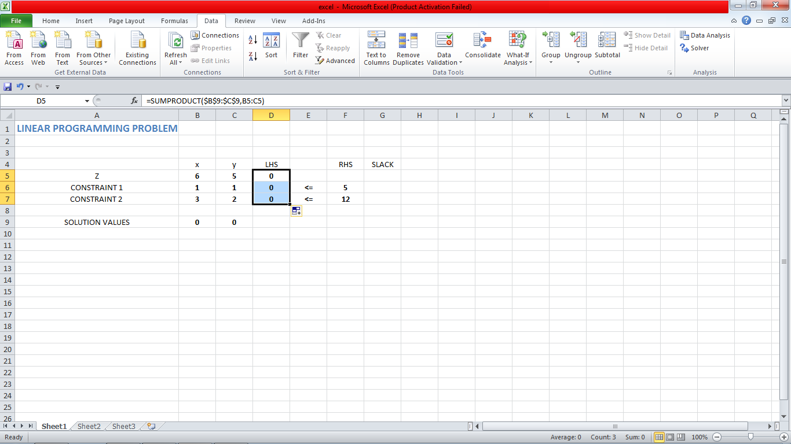

Slide 17
This fills the cells D5 through D7 with entries based on the formula in D4.If we click on cells D4 through D7 and examine the formula bar, we see a pattern.
CELL D4=SUMPRODUCT($B$9:$C$9,B5:C5)
CELL D5=SUMPRODUCT($B$9:$C$9,B6:C6)
CELL D6=SUMPRODUCT($B$9:$C$9,B7:C7)

Slide 18
In each of the cells, one factor in the product always comes from the solution values in cells B9 and C9. The other factor in the product comes from the cells in the B and C column on the same line. Cells that are fixed in a certain location are called absolute references and utilize the dollar sign. Cells that are located with respect to another cell are called relative references.
When cells are entered using a fill, relative references are filled with values according to their location. For this worksheet, the second part of each product comes from the cells immediately to the left and on the same row. The other part of the product is fixed by absolute references in B9 and C9.

Slide 19
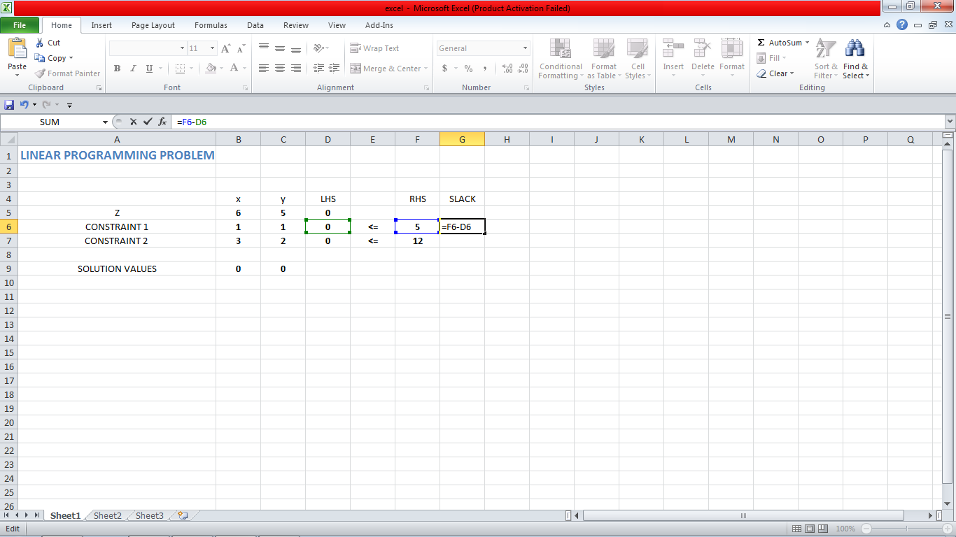
Now we’ll utilize a fill to put the entries under the “Slack” label. The slack is the difference between the right hand side and the left hand side of a constraint. Left mouse click on cell G5. In the formula bar, type =F6-D6.

Slide 20
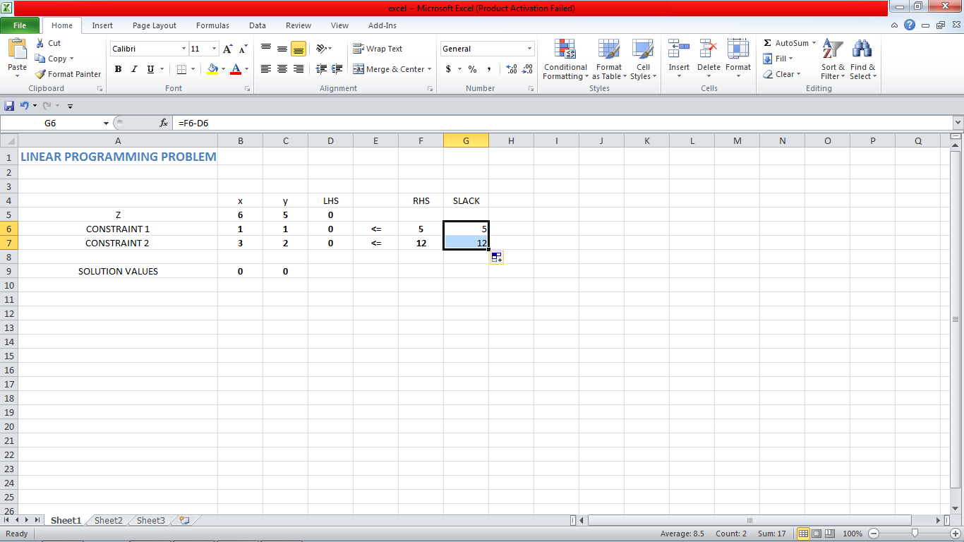
Press Enter to calculate the slack for the capacity constraint. This value is the difference between the left hand side and the right hand side of the Constraint 1.
Left mouse click in cell G6 again. Use the fill handle to fill the cells in G7.

Slide 21
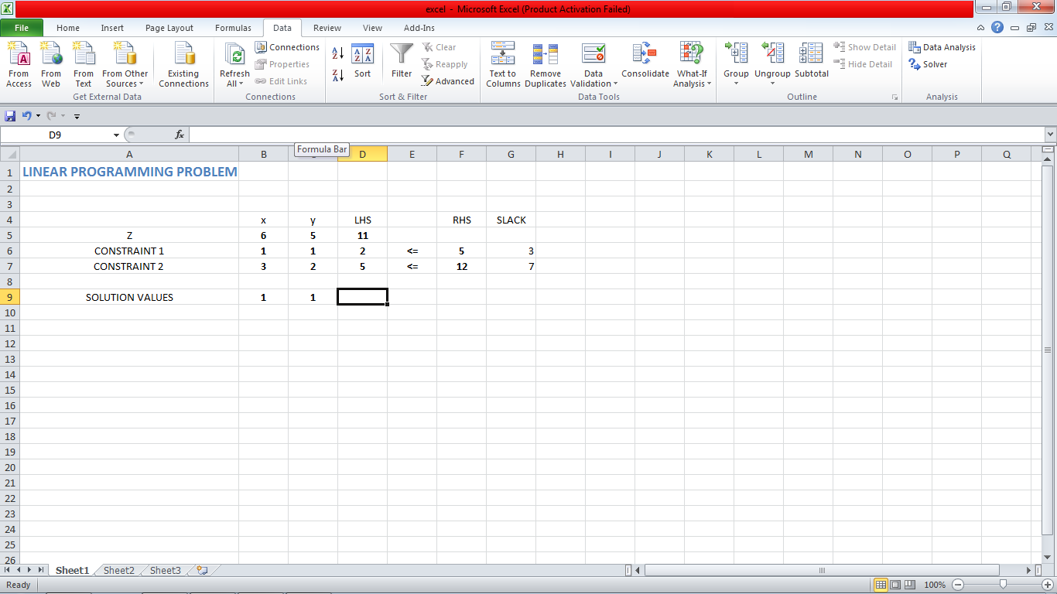
To test whether the cell entries are correct, let’s try some different values in the changing cells B9 and C9. Change both of these values to 1 and observe the values in the target cell D4, the left hand side values of the constraints in cells D5 through D7, and slack in G5 through G7. The values in those cells should match those shown below.

Slide 22
If any of the cells do not show the correct values, examine the contents of that cell and make changes to correct the entry or formula in the cell. Once the worksheet is calculating the proper values when the changing cells are varied , we can use the Solver Add-In to solve the linear programming problem.

Slide 23
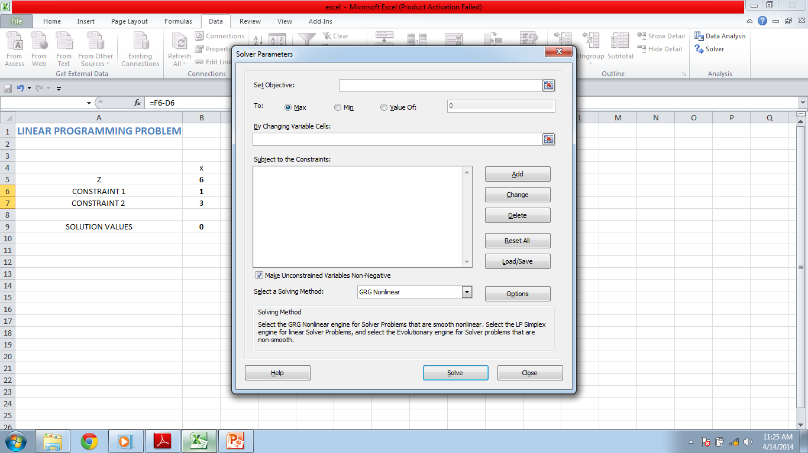
Click on the Data tab along the top of the Excel window.In the Analysis panel, click in the Solver button.

Slide 24
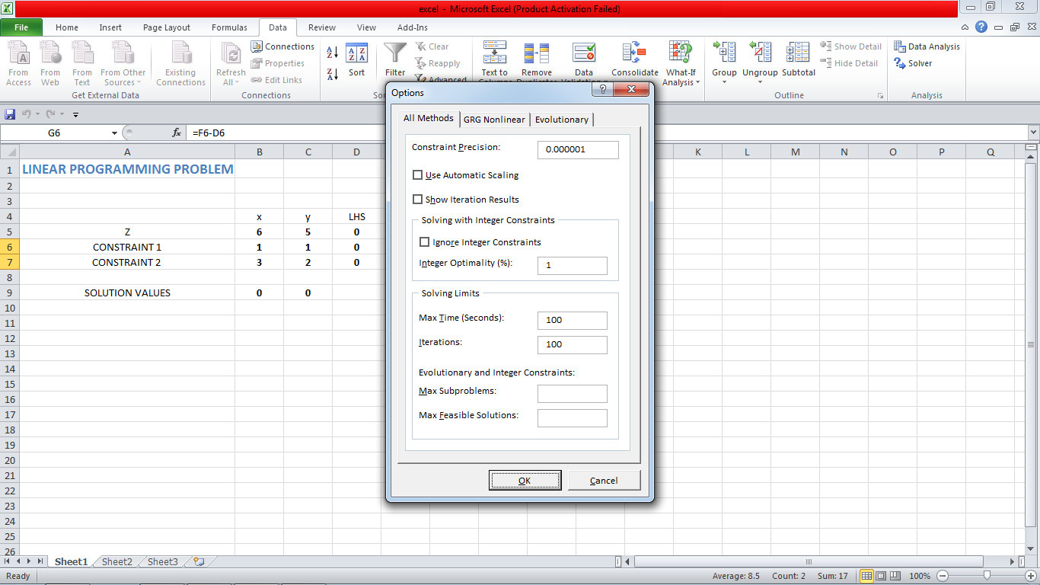
Before we can enter any values into the Solver Parameters box, we need to set some options. Click on the Options button.

Slide 25
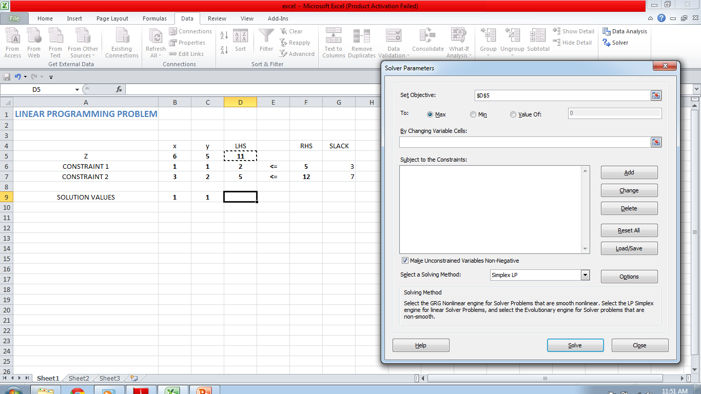
Make sure the cursor is positioned in the box next to the “Set Target Cell:”. Now click your mouse in cell D5. The absolute reference $D$5 will be placed in the box. This cell contains the value of the objective function evaluated at the solution values. Make sure Max is checked since we are maximizing the objective function.

Slide 26
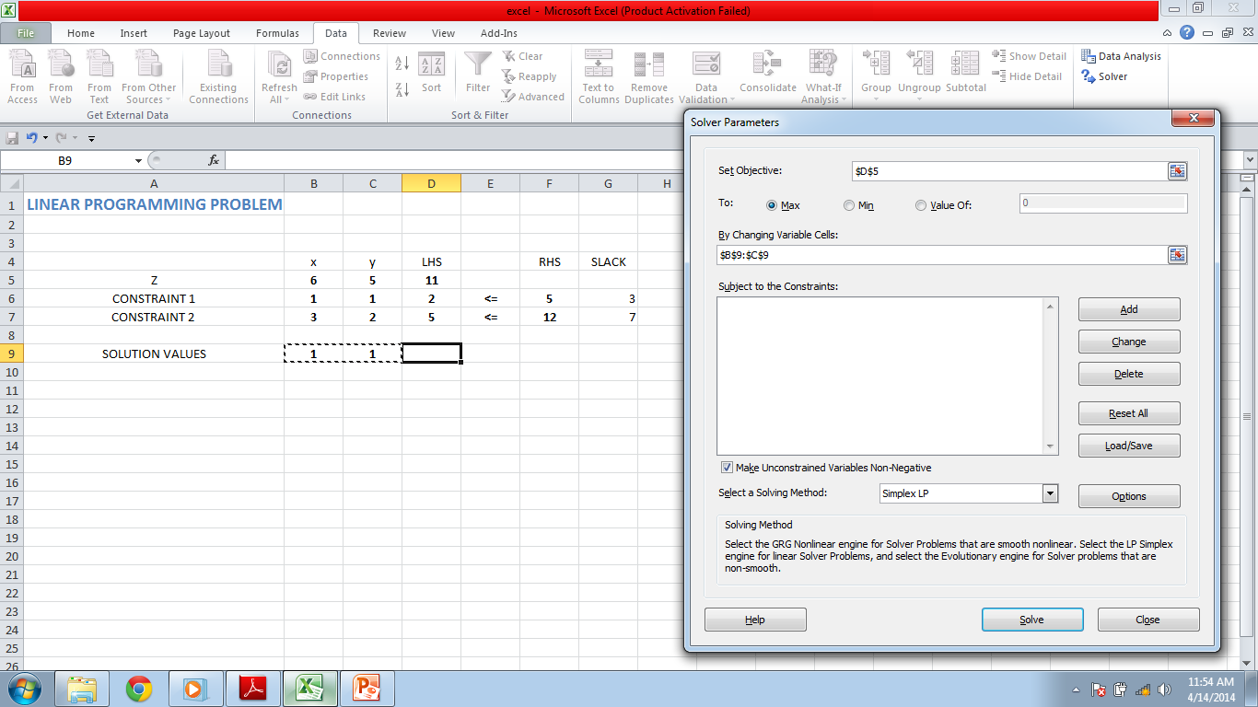
Position the cursor in the box below “By Changing Cells:”. Click and hold the left mouse button in cell B9. Drag the cursor to cell C9. This selects the two cells containing the guess for the solution values. The absolute references for the cells are placed into the Changing Cells box

Slide 27
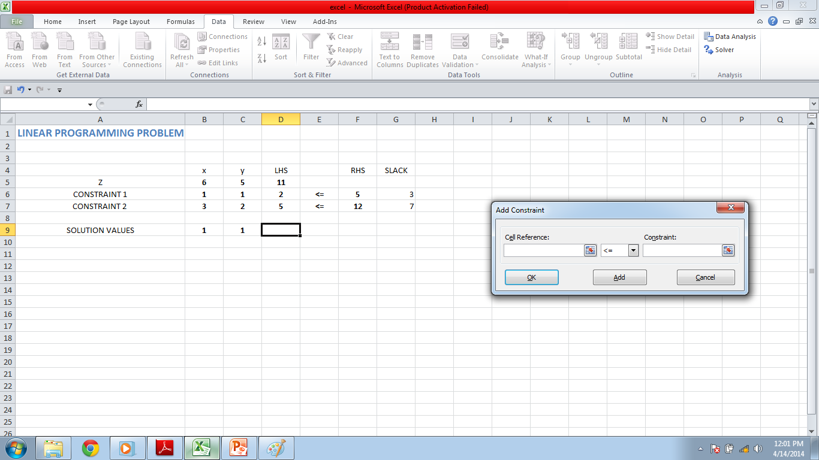
To enter the constraints into the Solver, click on the Add button under the “Subject to the Constraints” heading. The Add Constraint box will open and allow you to enter the left hand side, inequality, and right hand of the first constraint.

Slide 28
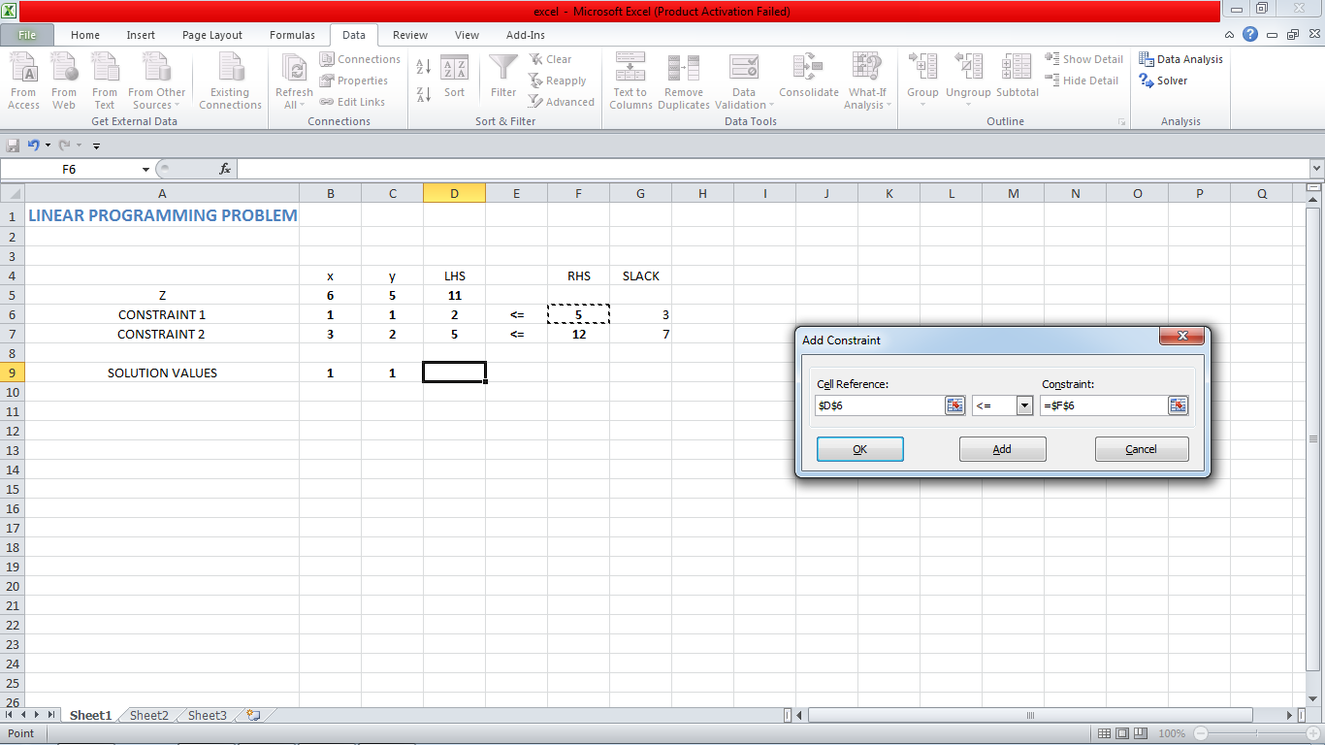
Position the cursor in the box under “Cell Reference”. Click on the cell containing the left hand side of the capacity constraint, D6. Next position the cursor in the box under “Constraints”. Click on the cell containing the right hand side of the capacity constraint, F6. Click the Add button.

Slide 29
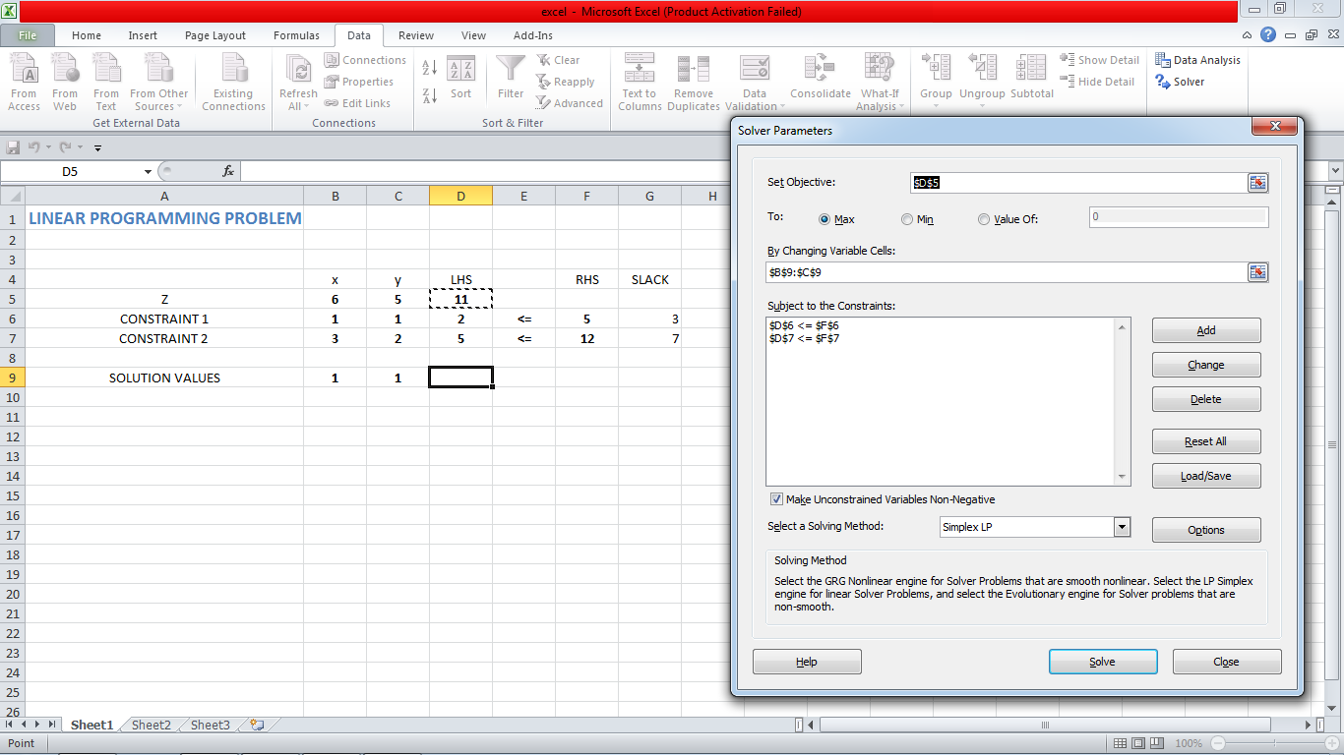
Repeat the above step for the other constraint and the corresponding cells for the left and right hand sides. It is not necessary to enter the non-negativity constraints. Once the constraints have been entered, click on the OK button in the Add Constraints box. You’ll return to the Solve Parameters box seen below.

Slide 30
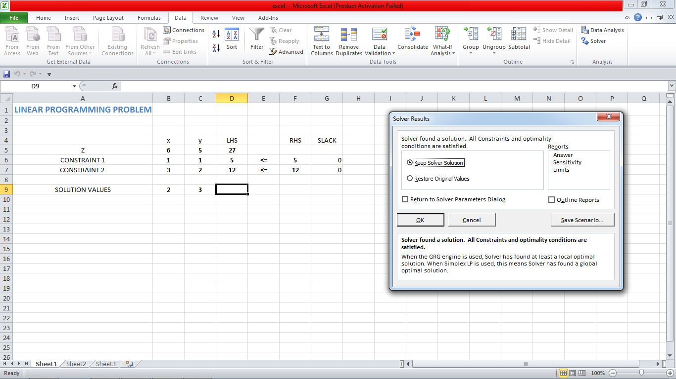
Click on the Solve button. The values in the cell are changed to correspond to the solution of the linear programming problem. According to Excel, the solution is (x, y) =(2,3).

Slide 31
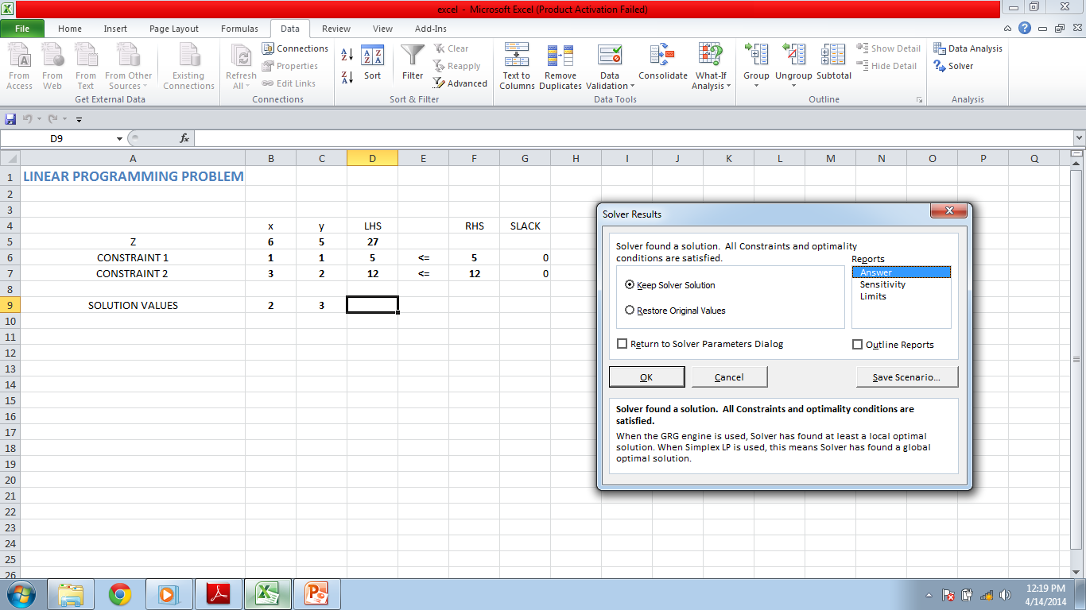
Highlight the Answer and Sensitivity Reports, and click on the OK button. Two new sheets will be created in your Excel workspace, Answer Report, and Sensitivity Report. You can click on the tab for either of these reports at the bottom of the Excel window to view them.

Slide 32
PREPARED BY: 11108EN033-42 B.TECH PART III MINING ENGINEERING IIT(BHU) SUBITTED TO: TARUN VERMA SIR

